Slide 1
GNSS LOCALISATION
Sub-group Leader: Pratham Lahoti - 2023A7PS0434G
Group Members:
Varun Bhatt - 2023A7PS0464G
Navya Agarwal - 2023A7PS0359G
Archit Sapra - 2023A7PS0348G

Slide 2
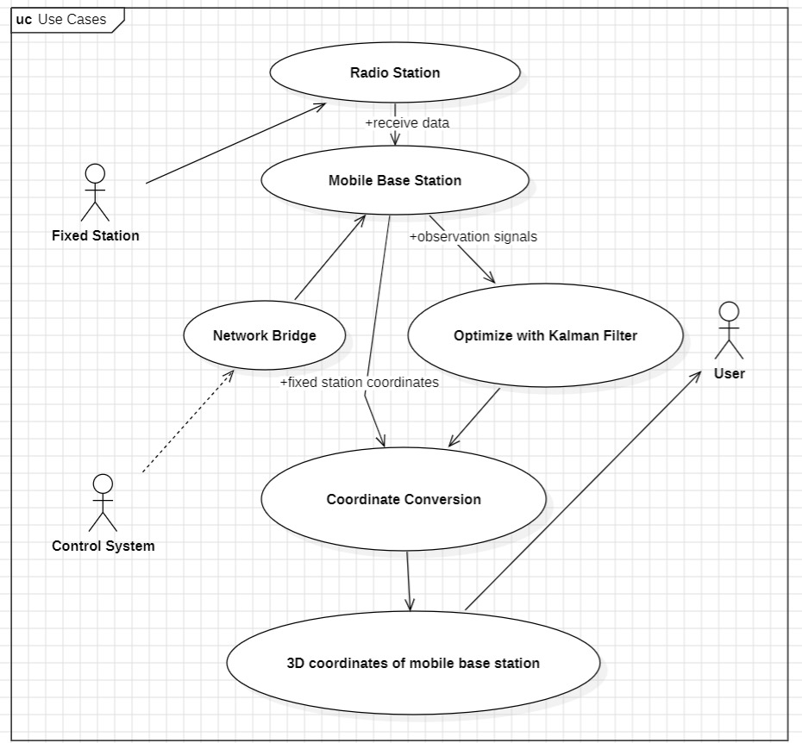
Use Case Diagram
This diagram represents use cases, including fixed stations, mobile base stations, network bridge, coordinate conversion, and Kalman filtering.

Slide 3
More Details on the Project
Description:
This project focuses on improving GNSS localization accuracy using fixed and
mobile base stations, optimizing data with Kalman filtering to provide real-time
positioning data.
Goals:
To achieve precise 3D coordinates for applications in navigation, surveying, and
autonomous operations.
To use signal optimization techniques to reduce errors in GNSS data.

Slide 4
Use Cases
Provides real-time, accurate positioning for autonomous cars, helping them stay on course, avoid obstacles, and optimize routes.
Assists autonomous vehicles in lane-keeping, safe lane changes, and maintaining distance between vehicles at high speeds using precise GNSS data.
Supports autonomous vehicles in complex urban environments where buildings can obstruct satellite signals, ensuring accurate localization in tight spaces.
Provides precise 3D coordinates for delivery robots navigating urban areas or industrial parks.
Enables real-time tracking and coordination for autonomous taxi fleets, improving efficiency in passenger pickups and drop-offs

